Slide 1


Up n smoke by Michelle Kat Carmen Haritha veethika
Date : 04/16/2024

Slide 2
Cannabis: it’s growing like a weed!
We were captivated by the ubiquitousness of marijuana everywhere: on ballots, on tv, in our cities, and in conversations with loved ones who rely on it for pain relief and mental health.
We wanted to know if we would find positive correlations and causations between this “budding industry” and crime and/or health, or would our project be “Up N Smoke”?

Slide 3
Cannabis Data: it’s hard to get
We wanted to know were mental health and crime levels affected by legalizing cannabis for recreational use?
We found plenty of summaries regarding mental health, but no one was willing to back it up.
Reached out to 5 scientists, including Pew Research Center, who published statistical analysis regarding mental health and its relationship with marijuana use to get the data. No one was willing to back up their claims by sharing their data.
Not only was this frustrating, but it causes their assertions to be suspect.

Slide 4
Project Progression: All the usual flame-outs
Data not available (without payment)
Initial decisions for database became problematic later: we built an entire database in PostgreSQL and did not use it
No data available for the national level
Had to learn new programs (Bokeh, PythonAnywhere and Py4web)
Investigated California, Colorado, and New Jersey because they recently legalized, but Massachusetts had the most comprehensive data over the course of several years, along with crime data. We could not find that with the other states.

Slide 5
Smokestack Building
We compiled nearly a million rows of data from a combination of resources:
FBI
State of Massachusetts
National Legalization Data
US Government Census
Kaggle
Data.gov
Samhsa.gov
Data.world
…to mention a few

Slide 6
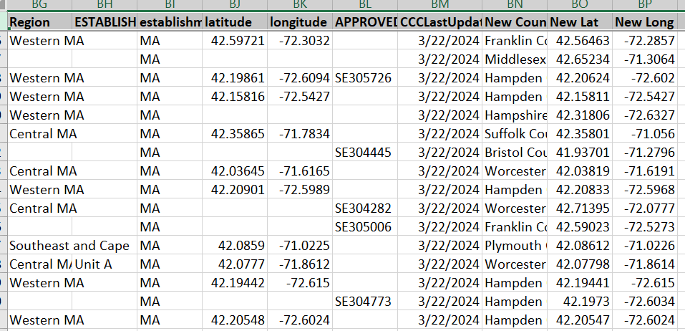
Data Gathering/Cleansing: Weeding
Data was downloaded from various sites
Files for crime were downloaded from FBI Crime data site
Data was cleansed and reverse-geocoded from geoapify site to get the missing data

Slide 7
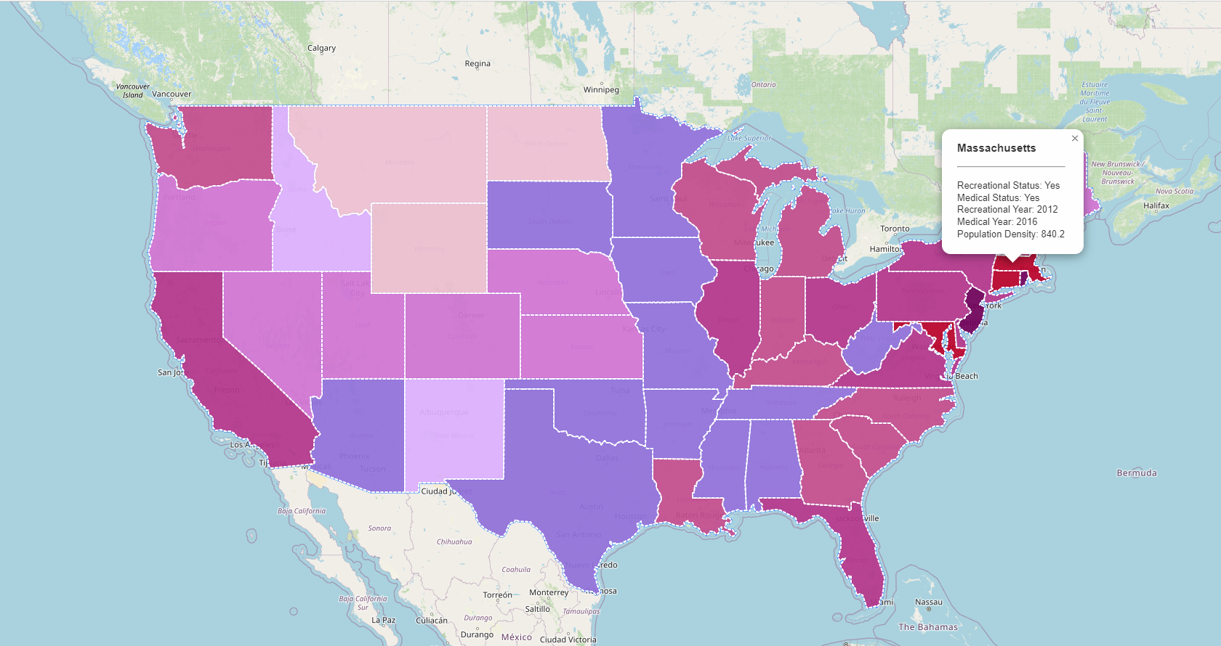
Who puffs and who doesn’t
National Data
Notes:
Transition to data gathered.

Slide 8


Crime Trends and Marijuana
This Photo by Unknown Author is licensed under CC BY-NC

Slide 9
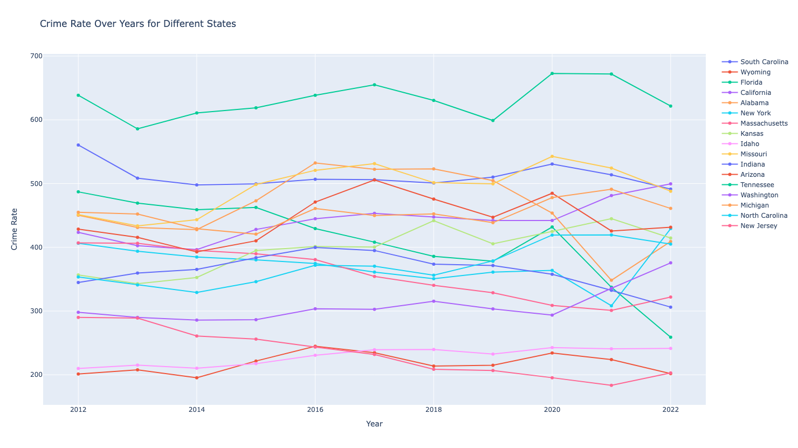
Crime Trends and Marijuana
Based on our analysis, legalization did not have any correlation to crime rates.
Sample states shown below include recreational use, medical only use, and illegal states.

Slide 10
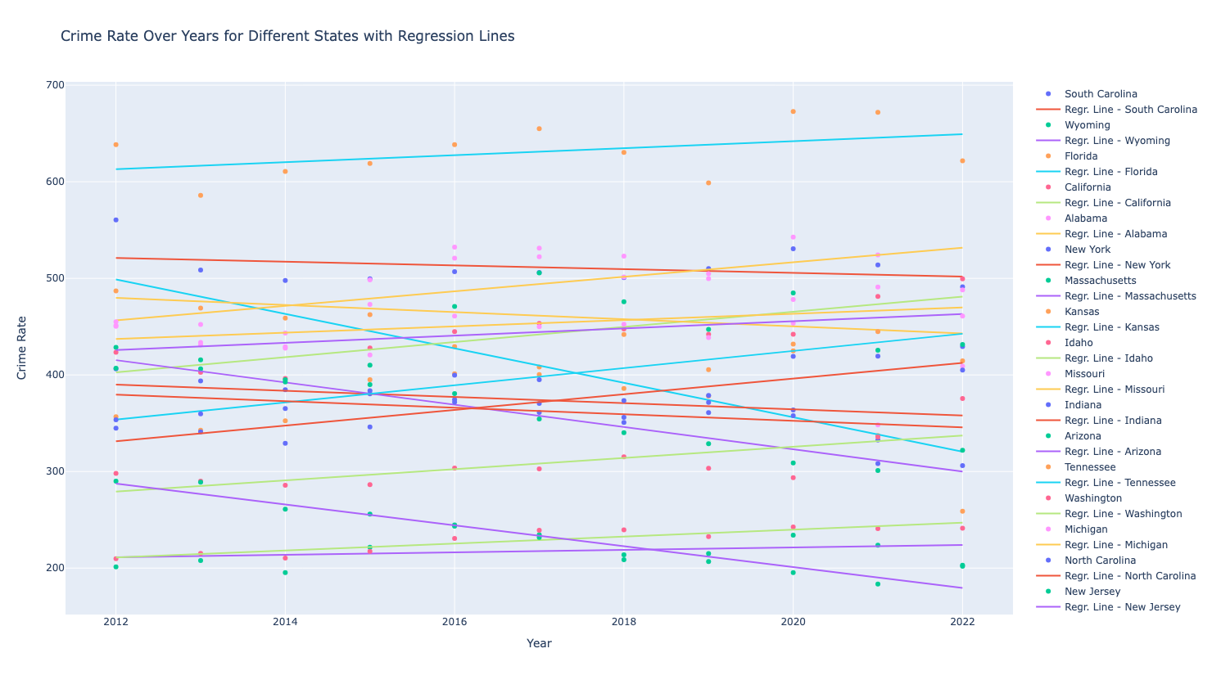
Crime Trends and Marijuana Put this in a pipe and smoke it!
Based on our analysis, legalization did not seem to have a clear correlation to crime rates.
Sample states shown below include recreational use, medical only use, and illegal states.
Although the data suggests that there is no direct correlation, this chart shows a decrease in crime for three states that recently legalized recreational use: Florida, New Jersey and Massachusetts. One hypothesis is that the possession of this subject is no longer classified as a crime, and this would be something we would have enjoyed investigating.

Slide 11

Focus on Massachusetts
This state’s data shows a drop in crime after recreational use was legalized as per the last slide.
Let’s take a deep puff of Massachusetts cannabis data.

Slide 12
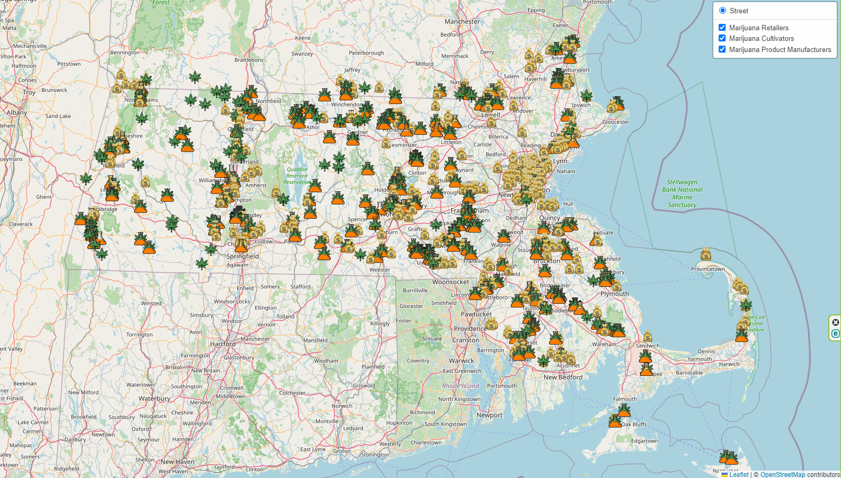
Massachusetts Focus
Live at Massachusetts Cannabis Related Businesses
More than just dispensaries! This data includes growing, transporting and development of products such as edibles.

Slide 13
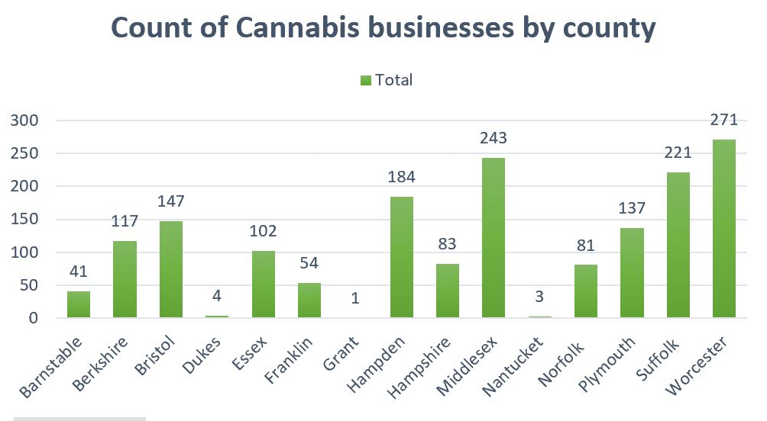
Massachusetts Focus
Cannabis Businesses at Massachusetts by county .

Slide 14
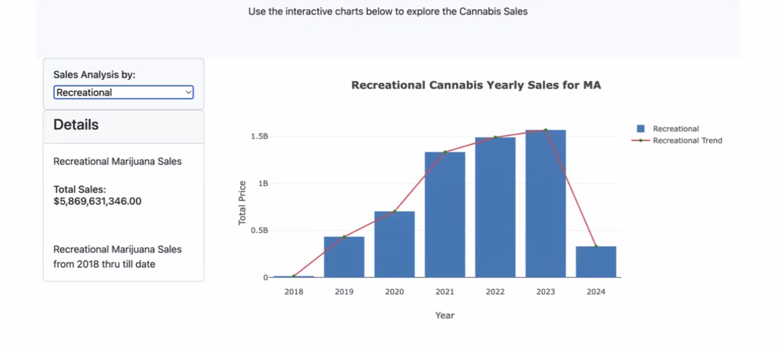
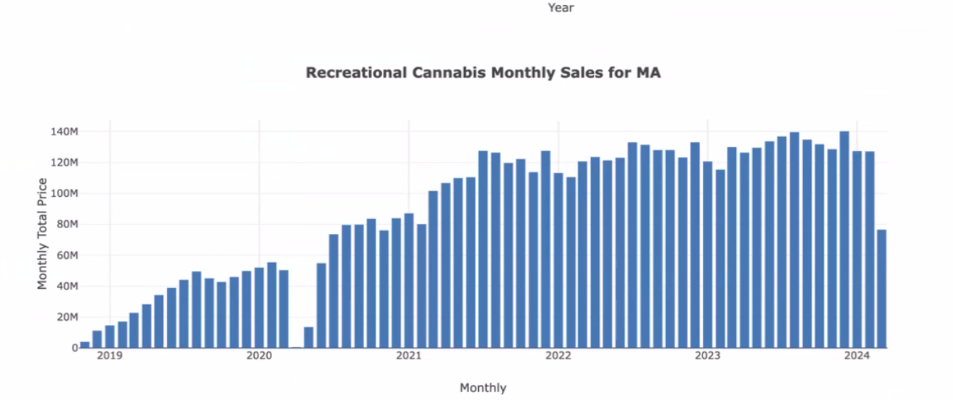
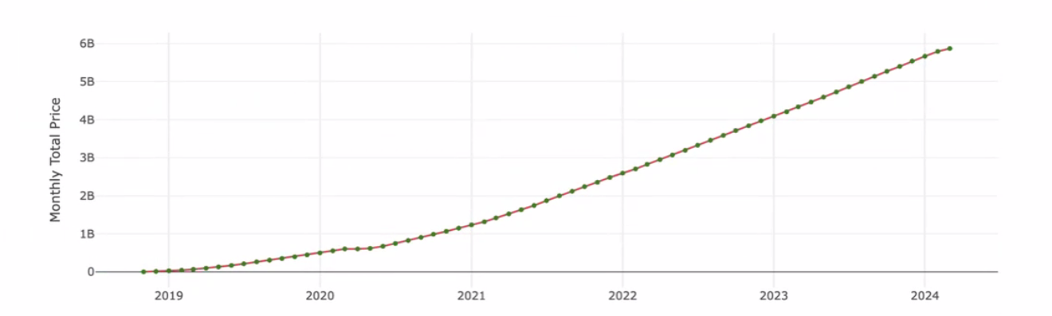
Cannabis Sales in MA: Recreational
Mass. Sales Data
Over 5.8 billion in sales since legalization
Steep increase in 2019, 2020 and 2021
Increases have slowed considerably
Cumulative Sales

Slide 15
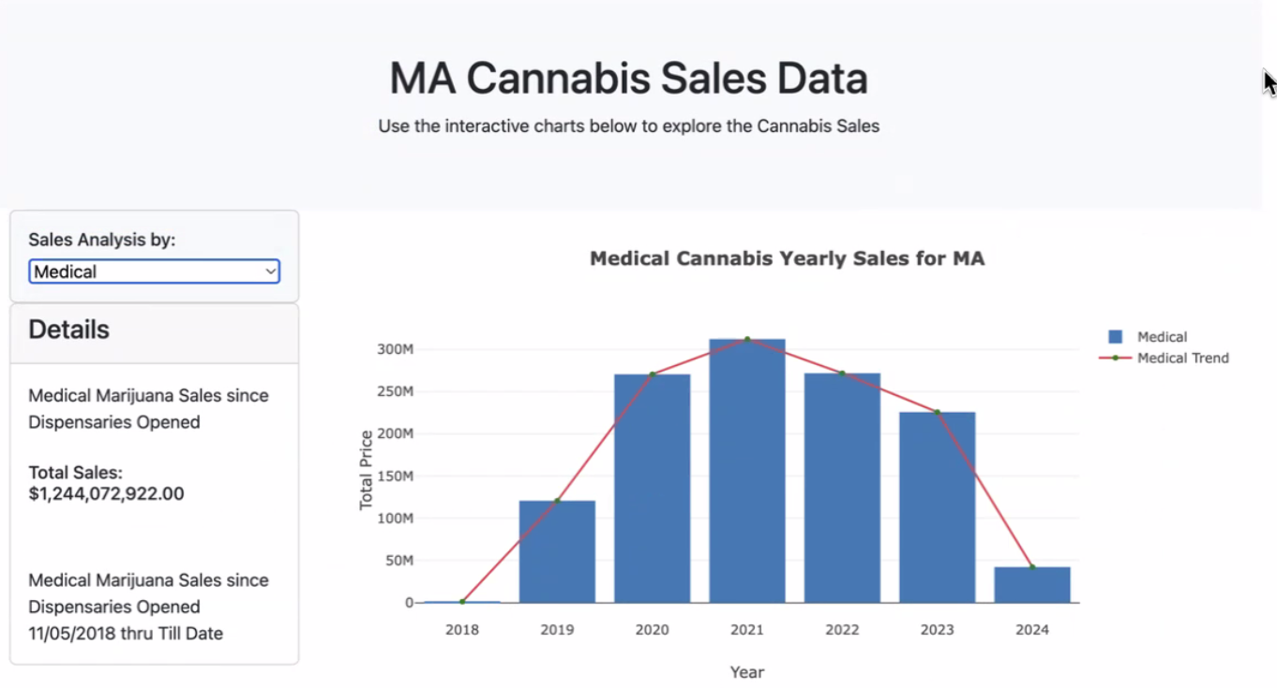
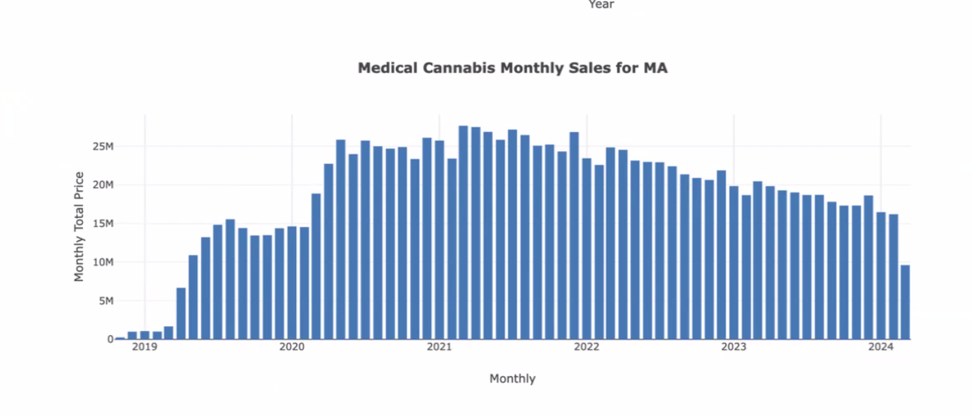
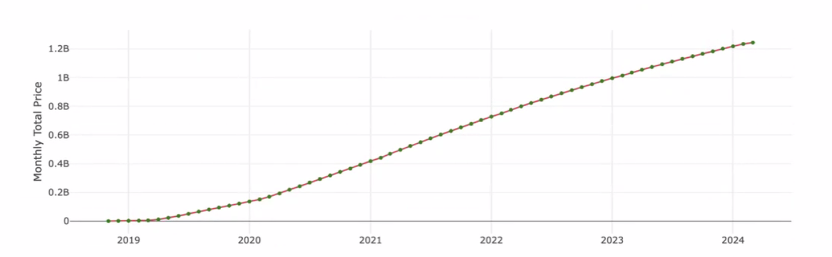
Cannabis Sales in MA: Medical
Over 1.2 billion in sales since legalization
Increasing in 2019, 2020
Downward trend since 2021
Cumulative Sales

Slide 16

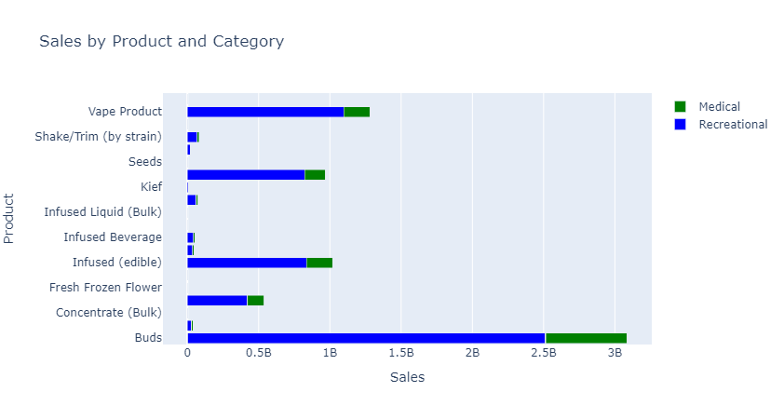
Massachusetts Sales: Product Category
In Massachusetts, sales of cannabis based on category and its use shows us that the biggest seller is buds by a significant margin.

Slide 17
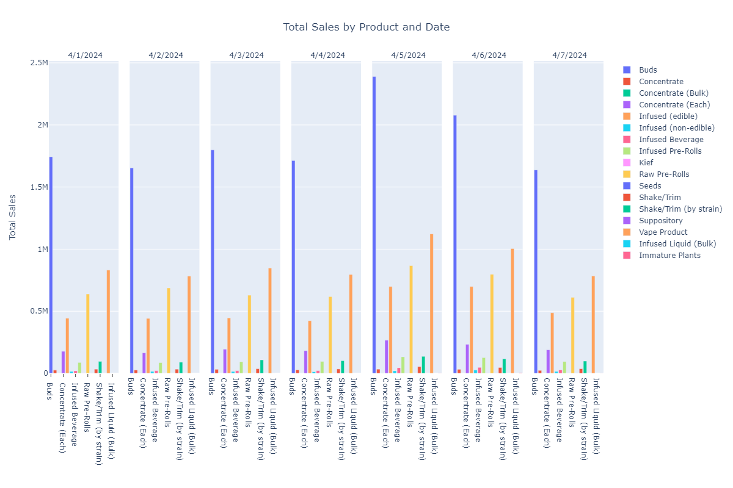
Massachusetts Weekly Sales -Recreational
In Massachusetts, sales of cannabis based on category and its use shows us that the biggest seller is buds by a significant margin.

Slide 18
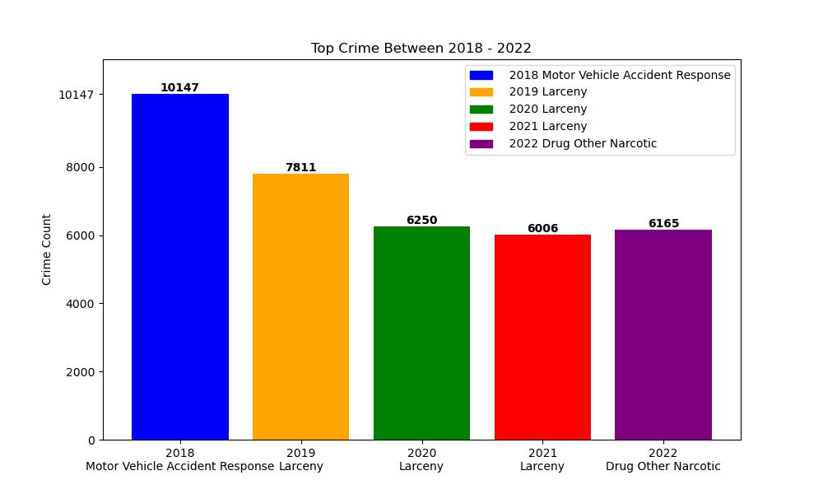
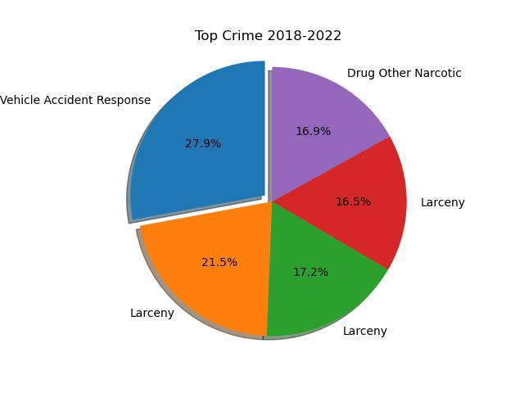
Massachusetts Crime: Clearing the Haze
Taking a more granular approach to Massachusetts, where crime has been on a seemingly significant downtrend, note that narcotics is not the primary criminal offense. Additionally, this category includes more than cannabis and represents such things such as heroin and methamphetamine abuse. This leads us to question how much the removal of cannabis as a violation in fact weighs on the calculation of criminal statistics. It would have helped to be able to access more information and further explore this hypothesis.

Slide 19
Fanning the Flames
Using national data as a high-level analysis, the data suggests that we are trending towards fully legalizing cannabis at a national level. Including the District of Columbia, currently in 25 states recreational use is legal, while 16 allow medical use only, and 10 still criminalize marijuana use.
If we consider Massachusetts as a microcosm reflecting potential future trends, it seems that moving forward, as states embrace recreational use, people are less likely to go through the process of getting their medical card and therefore medical sales might trend down and recreational sales will sharply increase before transitioning to a more stable trend.
Of course, many factors can affect this, including insurance coverage of medical marijuana, political pressures, and legal challenges.

Slide 20

The End
DISCLAIMER
While our presentation perhaps suggests the possibility of endorsement due to our in-depth research, we would support one creating one’s own null hypothesis and conduct one’s own research, however one chooses to proceed.
We do not endorse the use of marijuana ourselves
… allegedly.

